Slide 1
Linear Algebra For ML
Vectors Operations
1 Addition
2 Subtraction
3 Multiplication
4 Division
Usage In ML

Slide 2
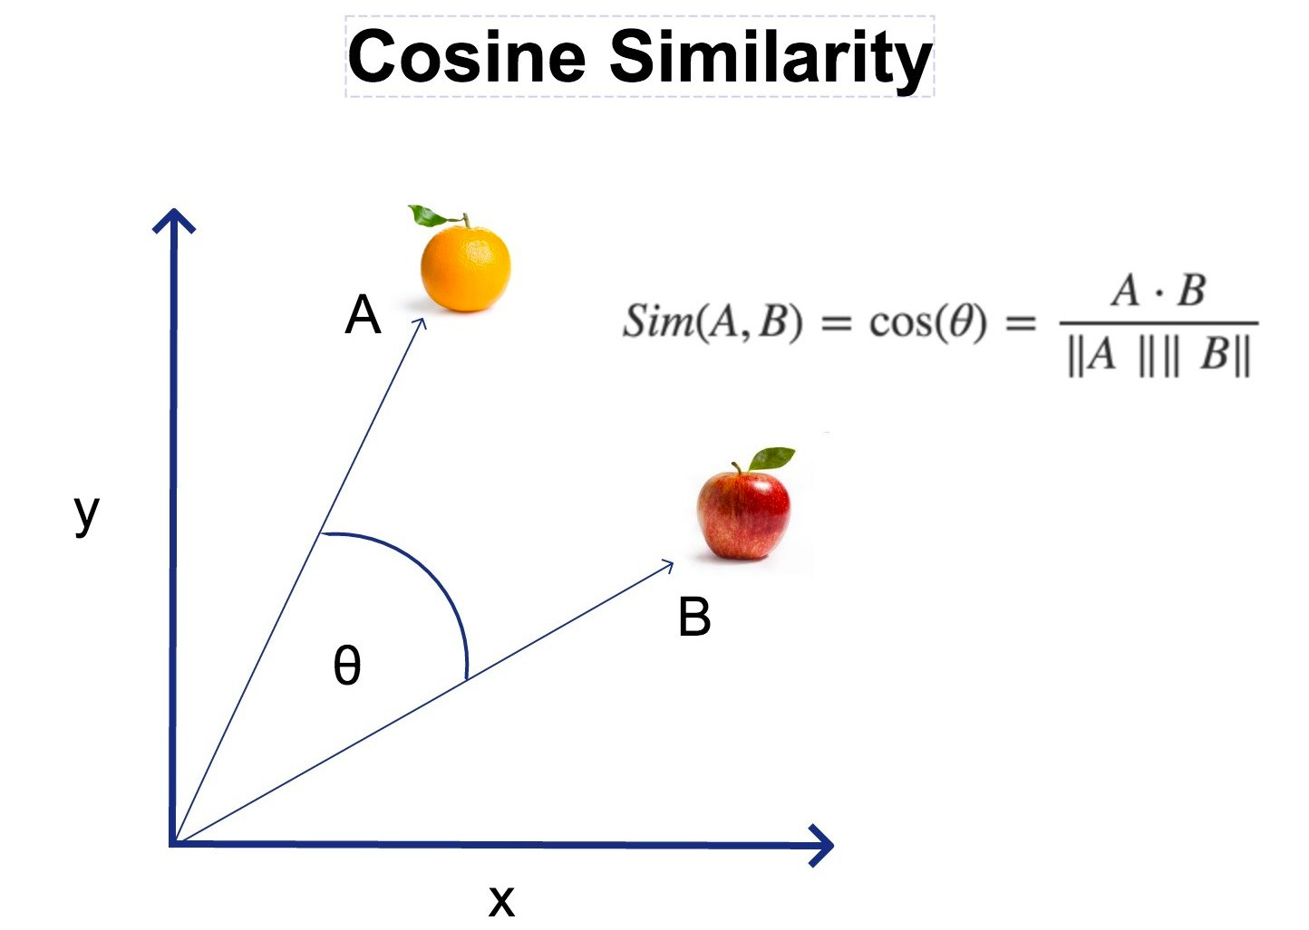
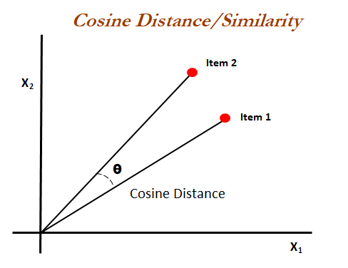
Where & When We Do Vector Operations in ML
1. Data Representation
ML Component | Vector Operations Used
Data preprocessing | Subtraction, division
Model forward pass | Dot product, matrix-vector multiplication
Training (gradient) | Vector subtraction, scalar multiplication
Similarity & distance | Dot product, norm, subtraction
Word/image embeddings | Vector arithmetic (add/subtract)
Attention mechanism | Dot product, softmax
image of size 28x28 is flattened into a 784-dimensional vector.
Vector operation: dot, add, scale, etc., for transformation and normalization.
2. Data Preprocessing
Normalization / Standardization Subtract mean → vector subtraction Divide by std → vector-scalar division
3. Model Training
Linear Regression, Logistic Regression Uses dot products:
y=w⋅x+b
4. Cosine Similarity (NLP & Recommenders)
Used to measure similarity between word vectors, user vectors, etc.:
Applications:
Text similarity
Recommendation engines
Word2Vec / Embedding models

Slide 3
Addition of Vectors
Algebraic Method (Component-wise addition)
If you have two vectors:
A = (a₁, a₂)
B = (b₁, b₂)
Then their sum A + B = (a₁ + b₁, a₂ + b₂)
Example 1: 2D Vectors
Let A = (3, 4) B = (1, 2)
Solution: A + B = (3 + 1, 4 + 2) = (4, 6)
So, the resultant vector is (4, 6).
Example 2: 3D Vectors
Let A = (2, -1, 3) B = (4, 0, -2)
Solution: A + B = (2 + 4, -1 + 0, 3 + (-2)) = (6, -1, 1)
Resultant vector = (6, -1, 1)

Slide 4
Subtraction of Vectors
Algebraic Method (Component-wise subtraction)
If you have two vectors:
A = (a₁, a₂)
B = (b₁, b₂)
Then their difference A − B = (a₁ − b₁, a₂ − b₂)
You can also think of vector subtraction as:
A − B = A + (−B) Where −B is the vector B flipped in direction.
Example 1: 2D Vectors
Let A = (7, 3) B = (2, 5)
Solution:
A−B=(7−2,3−5) = (5,−2)
Resultant vector = (5, -2)
Example 2: 3D Vectors
Let A = (4, -1, 2) B = (1, 3, -2)
Solution:
A−B=(4−1,−1−3,2−(−2))=(3,−4,4)
Resultant vector = (3, -4, 4)

Slide 5
Multiplication of Vectors
Types of Vector Multiplication
There are two common types of vector multiplication:
Dot Product (Scalar Product)
Cross Product (Vector Product)
1. Dot Product
Formula (for vectors A and B in 2D or 3D):
If A = (a₁, a₂) and B = (b₁, b₂) then
A⋅B=a1​⋅b1​+a2​⋅b2​
In 3D: A = (a₁, a₂, a₃), B = (b₁, b₂, b₃)
A⋅B=a1.​b1​+a2.​b2​+a3​.b3​
2. Cross Product (Only in 3D)
Formula:
If A = (a₁, a₂, a₃) and B = (b₁, b₂, b₃) the
A×B=(a2​b3​−a3​b2​,a3​b1​−a1​b3​,a1​b2​−a2​b1​)

Slide 6
Multiplication of Vectors
Types of Vector Multiplication
There are two common types of vector multiplication:
Dot Product (Scalar Product)
Cross Product (Vector Product)
Example 1: 2D Dot Product
A = (3, 4) B = (2, -1)
A⋅B=3×2+4×(−1)=6−4=2
Result = 2
Example 2: 3D Dot Product
A = (1, 2, 3) B = (4, -1, 2)
A⋅B=1×4+2×(−1)+3×2=4−2+6=8
Result = 8
Example: Cross Product
A = (1, 2, 3) B = (4, 5, 6)
A×B=(2×6−3×5,3×4−1×6,1×5−2×4)
=(12−15,12−6,5−8)
=(−3,6,−3)
Type | Result Type | Operation | Use Case
Dot Product | Scalar | a₁b₁ + a₂b₂ (+ a₃b₃) | Angle, projection, similarity
Cross Product | Vector | 3D only: perpendicular vector | Torque, surface normal, geometry

Slide 7
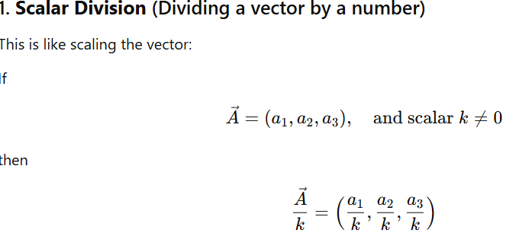
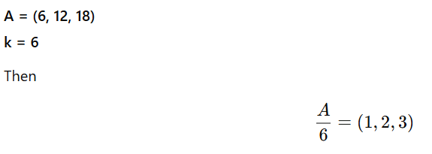
Division of Vectors
Is Vector Division Possible?
There is no standard "vector division" like there is for addition, subtraction, or multiplication.
Why Not?
Division would require an inverse of a vector, but:
Vectors don’t have a multiplicative inverse like numbers do.
There's no meaningful geometric interpretation of dividing one vector by another.
Operations like:
A⃗÷B⃗
are undefined in standard linear algebra.
Operation | Valid? | Notes
Vector ÷ Vector | No | Not defined in linear algebra
Vector ÷ Scalar | Yes | Scalar division (scaling)
Element-wise ÷ | Yes | Used in code, not standard in pure math

